Slide 1
Spring MVC In 28 Min’s

Slide 2
Notes
Pom.xml is the most important component used by maven.
Maven is java dependency management tool.
If we run a java app.'s using Spring or Hibernate we need Spring.jar or Hibernate.jar files.
But here in maven, it download all necessary jars it self, this process is called dependency management.

Slide 3
Once we add a dependency in pom.xml then maven would automatically go and get it from a repository and make it available for his project.

Slide 4
Pom.xml:
We configured “tomcat7-maven-plugin” , so maven download tomcat for us in our project.
We need at least one server to run a web application, here in our case it is tomcat.
Also we configured “maven-compiler-plugin” , so maven will take care of compiling java classes we write in our project.
Then we add a dependency called “javaee-web-api”, we add a jar as a dependency.

Slide 5
Web.xml:
We created a welcome file called “login.do” , it redirects the user to login.do we can even provie a display name in the web page.

Slide 6
LogInServlet.Java:
It is a servlet, it extends HttpServlet.
Servlet is a class that takes input as a http request and gives out put as http response.
When ever we enter “localhost:8080” in the browser , then browser will send to GET request to the server “localhost:8080”, along with request few request headers were also sent.
After that it sends a response back to user with html content.

Slide 7
@WebServlet : Annotation to handle url mapping.
JSP: Java server pages, why jsp instead of java because, java is good at writing business logic, but not a static content or html pages.
So we use jsp to handle html content like writing dynamic content to web browser.
At the end jsp is converted into servlet.

Slide 8
Response status code for successful status is : 200,
If the response status code is 404 it means , page is not found in the specified path.
405 : Post method is not allowed in that servlet

Slide 9
Passing request parameters using GET method
Need to type “localhost:8080/?name=Yogesh”.
name : parameter , Yogesh : value
String name = request.getParameter(“name");
request.setAttribute(“name",name);
String name = request.getParameter(“country");
request.setAttribute(“country",name);

Slide 10
Here we are getting the parameter called country, and passing that parameter as attribute to jsp (that’s why we are using setAttribute() method). So that jsp can display that country name on the web page.
For that in login.jsp we need to use expression language “ ${country} ” element, So that jsp can dynamically take that parameter and then it displays on the web page.

Slide 11
Browser Servlet
Request parameter as attribute
JSP
Here the request parameter is passed from browser to servlet, then servlet passes it as an attribute to jsp , so that jsp can display that content on web page.

Slide 12
Scriplets
As we discussed JSP is nothing but a servlet, what ever we can do in servlet , we can do it in JSP.
We can writes java code in side jsp, but it is not a recommended approach , but we must know there is a possibility to write some java code in side JSP.
In JSP what ever we write in side <% text %> is called srciplet.
EX: <% System.out.println(“Dummy code”) %>
- So we can see that that output : Dummy code on the console.

Slide 13
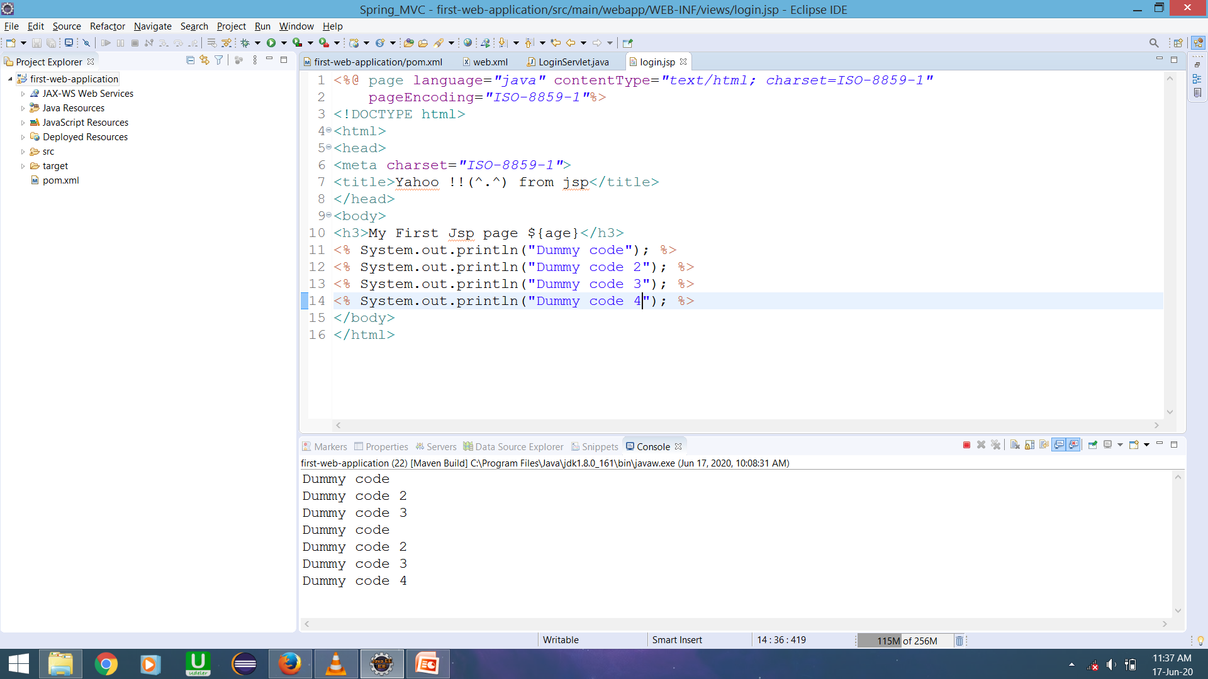

Slide 14
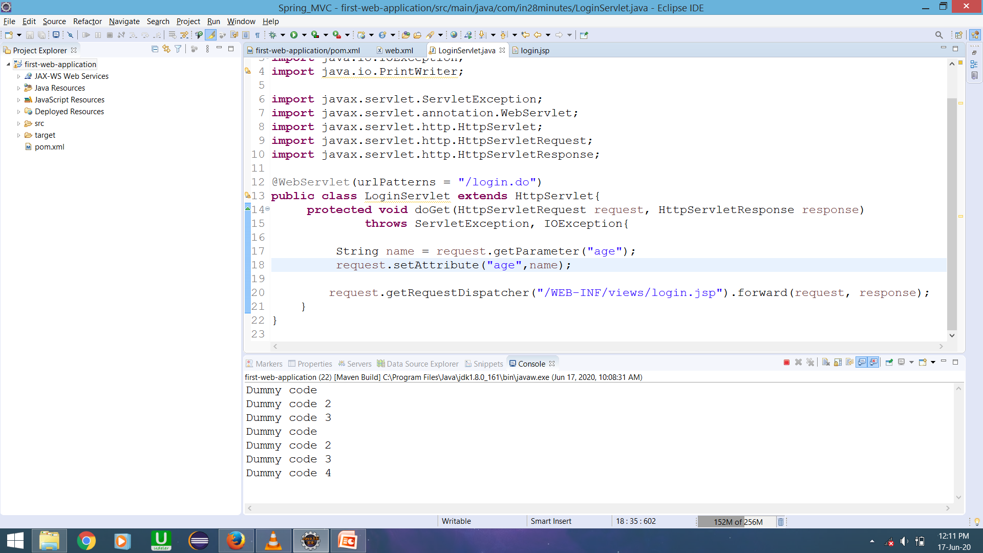

Slide 15
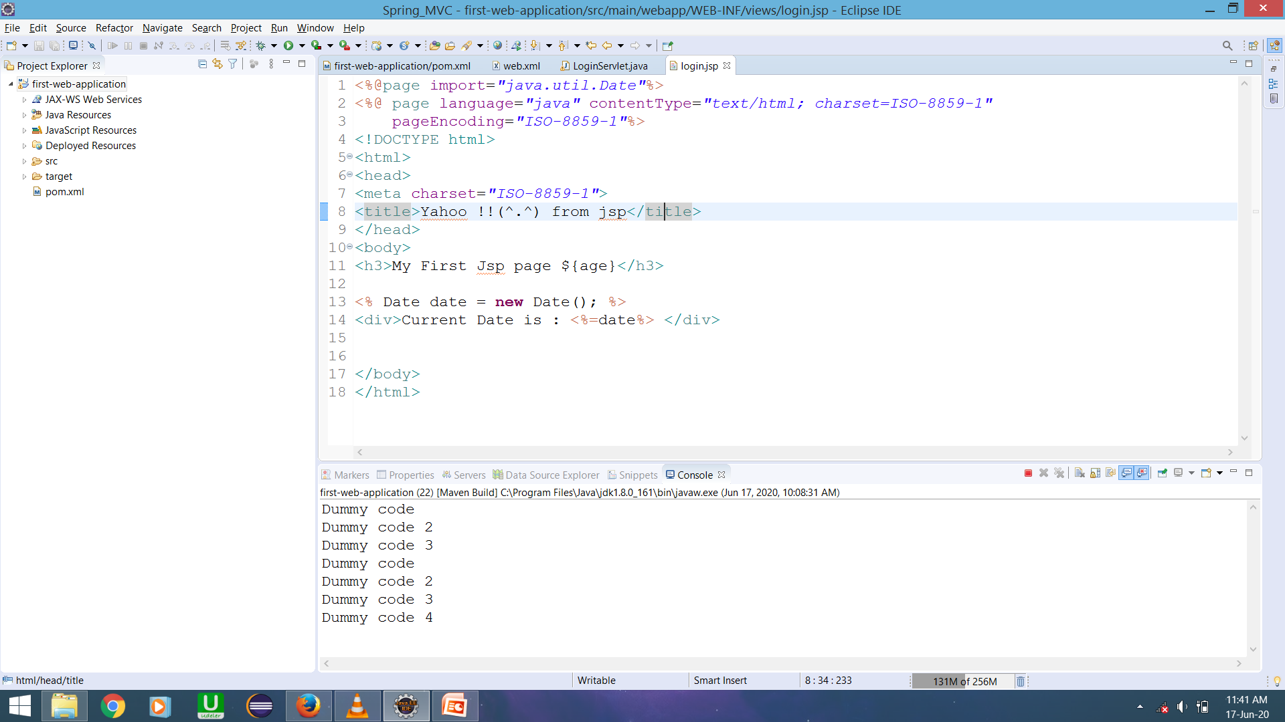
We can even print current date, import packages as same as in normal java programs

Slide 16
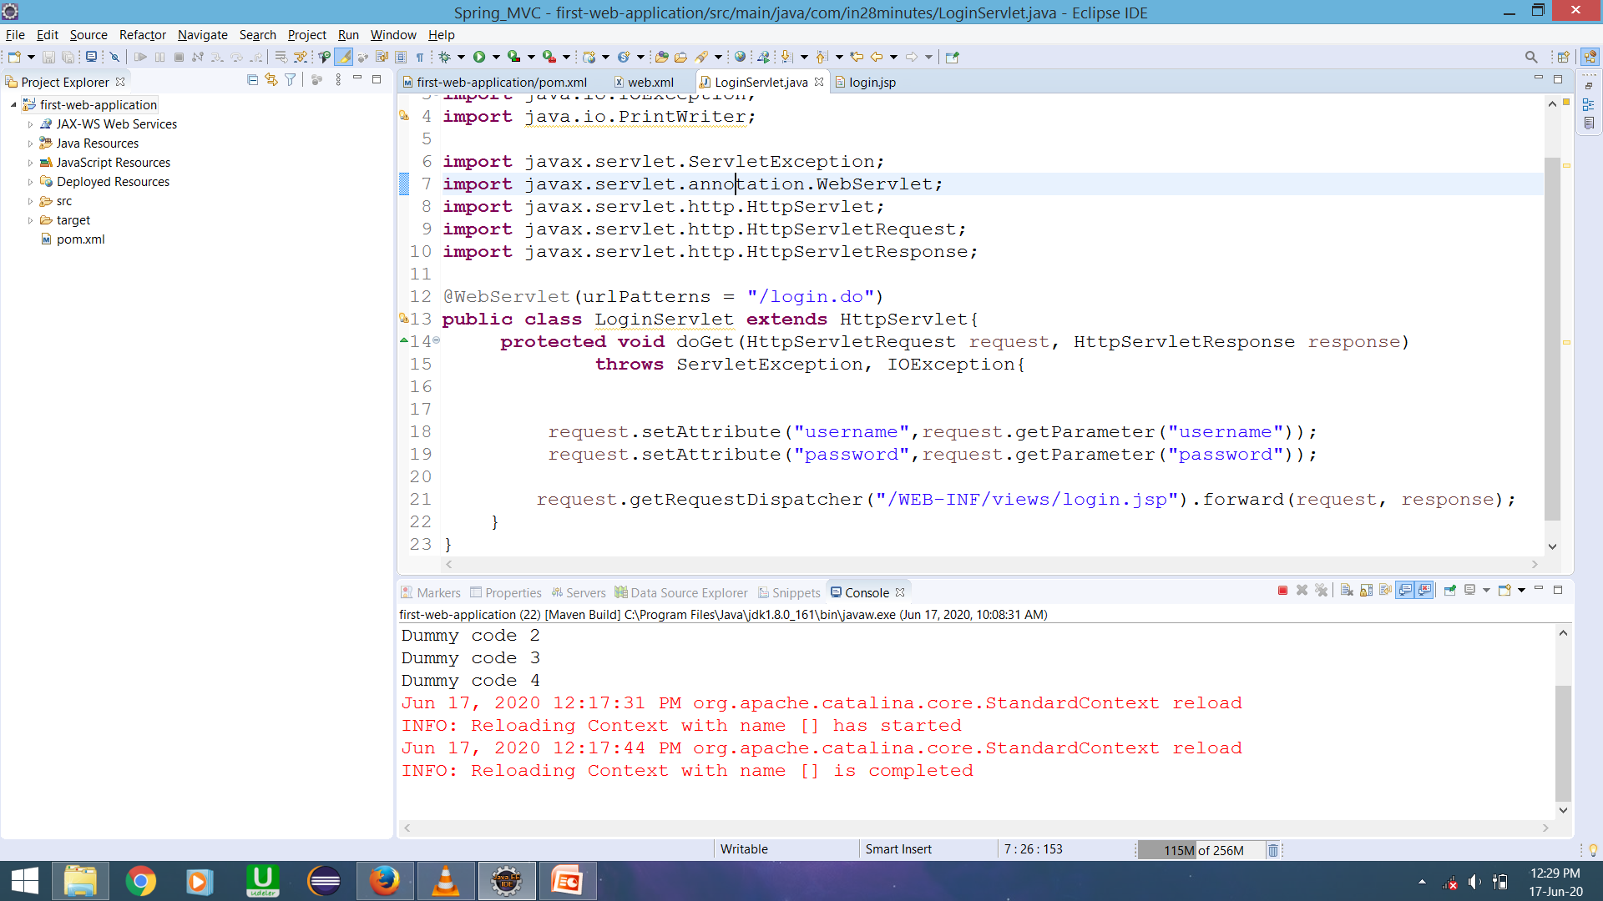
Code modified at line 17

Slide 17
For better practice we will never use Scriplets or java code in JSP. Instead we use only expression language (${text}) or html content in JSP.
JSP is a view , so we not meant to add any java code in it.

Slide 18
Disadvantages of getParameters
If we pass sensitive information like password and username in url, the request pass through multiple routers over the network.
So we can’t send the sensitive information in the url. It is nor secure.
That’s why we use another http request called post.

Slide 19
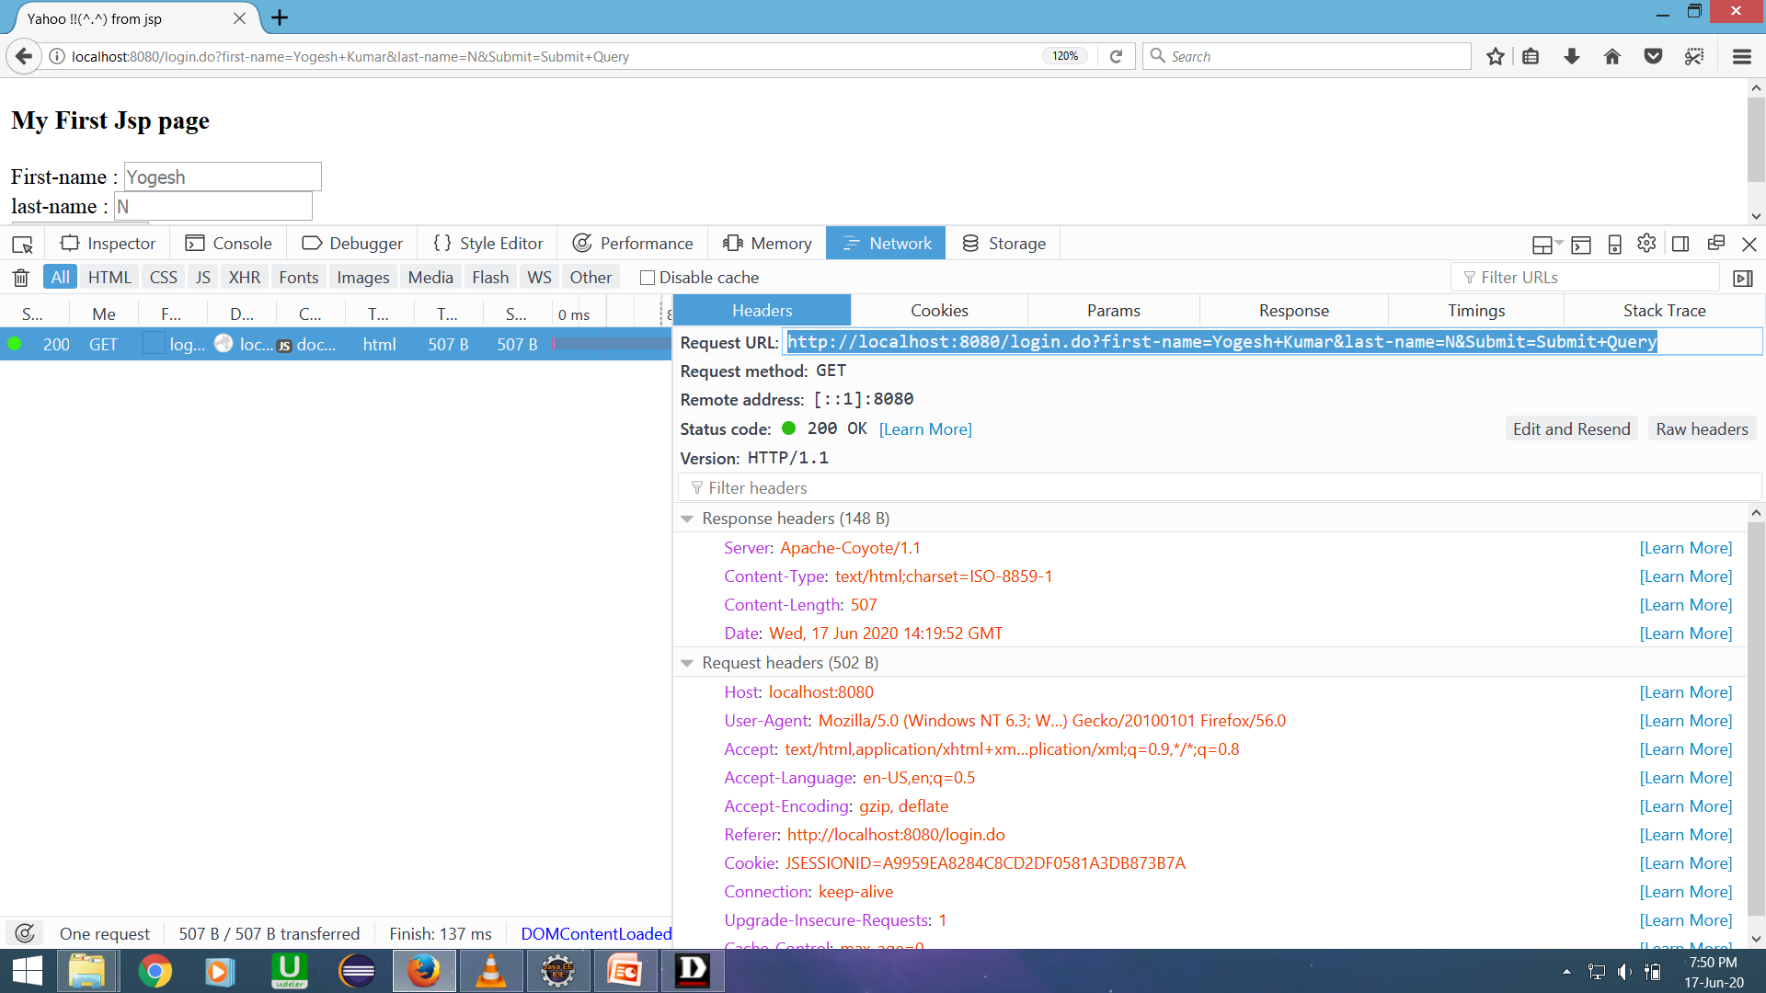

Slide 20
As we can see in the above slide , if we sent request using GET method , the first-name and last-name are passing through the URL.
This is the main disadvantage of using GET method, That why We use POST method.
If we use the POST method to send the request , it does not display the sensitive information in the URL.

